Slide 1
Routing algorithm

Slide 2
In order to transfer the packets from source to the destination, the network layer must determine the best route through which packets can be transmitted.
Whether the network layer provides datagram service or virtual circuit service, the main job of the network layer is to provide the best route. The routing protocol provides this job.
The routing protocol is a routing algorithm that provides the best path from the source to the destination. The best path is the path that has the "least-cost path" from source to the destination.
Routing is the process of forwarding the packets from source to the destination but the best route to send the packets is determined by the routing algorithm.

Slide 3
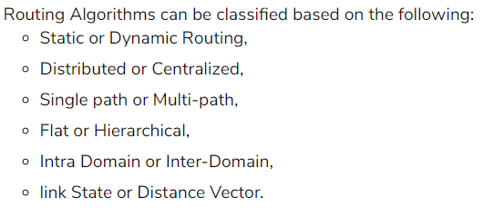
Classification of a Routing algorithm

Slide 4
Distance Vector Routing Algorithm
The Distance vector algorithm is iterative, asynchronous and distributed.
  Distributed: It is distributed in that each node receives information from one or more of its directly attached neighbors, performs calculation and then distributes the result back to its neighbors.
  Iterative: It is iterative in that its process continues until no more information is available to be exchanged between neighbors.
  Asynchronous: It does not require that all of its nodes operate in the lock step with each other.
The Distance vector algorithm is a dynamic algorithm.
It is mainly used in ARPANET, and RIP.
Each router maintains a distance table known as Vector.

Slide 5
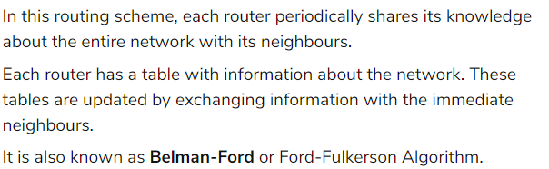

Slide 6
Three Keys to understand the working of Distance Vector Routing Algorithm
Knowledge about the whole network: Each router shares its knowledge through the entire network. The Router sends its collected knowledge about the network to its neighbors.
Routing only to neighbors: The router sends its knowledge about the network to only those routers which have direct links. The router sends whatever it has about the network through the ports. The information is received by the router and uses the information to update its own routing table.
Information sharing at regular intervals: Within 30 seconds, the router sends the information to the neighboring routers.

Slide 7
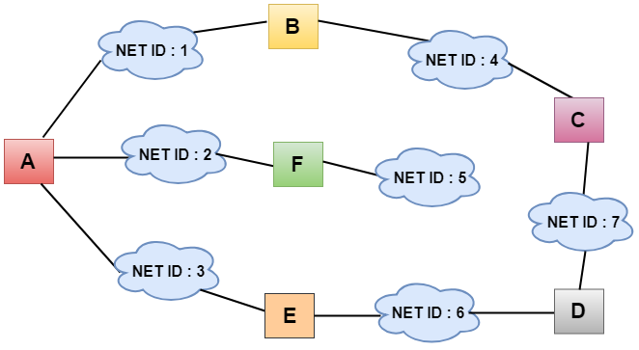
Let's understand through an example
Sharing Information

Slide 8
In the above figure, each cloud represents the network, and the number inside the cloud represents the network ID.
All the LANs are connected by routers, and they are represented in boxes labeled as A, B, C, D, E, F.
Distance vector routing algorithm simplifies the routing process by assuming the cost of every link is one unit. Therefore, the efficiency of transmission can be measured by the number of links to reach the destination.
In Distance vector routing, the cost is based on hop count.

Slide 9
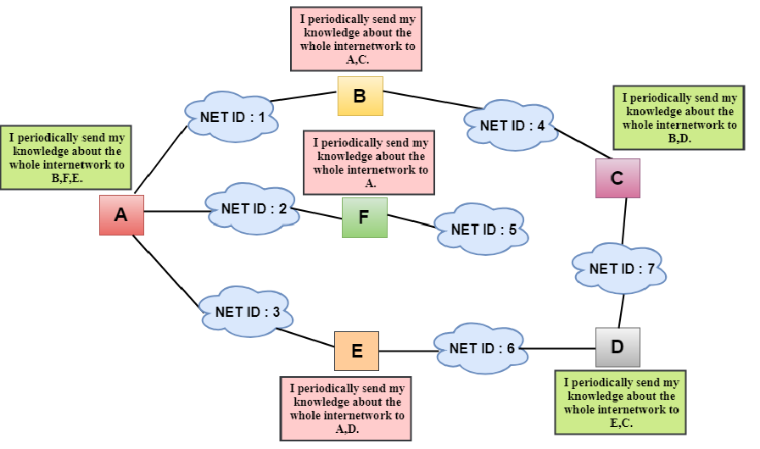
In the above figure, we observe that the router sends the knowledge to the immediate neighbors.
The neighbors add this knowledge to their own knowledge and sends the updated table to their own neighbors.
In this way, routers get its own information plus the new information about the neighbors.

Slide 10
Routing Table
Two process occurs:
Creating the Table
Updating the Table
Initially, the routing table is created for each router that contains atleast three types of information such as Network ID, the cost and the next hop.
NET ID: The Network ID defines the final destination of the packet.
Cost: The cost is the number of hops that packet must take to get there.
Next hop: It is the router to which the packet must be delivered.

Slide 11
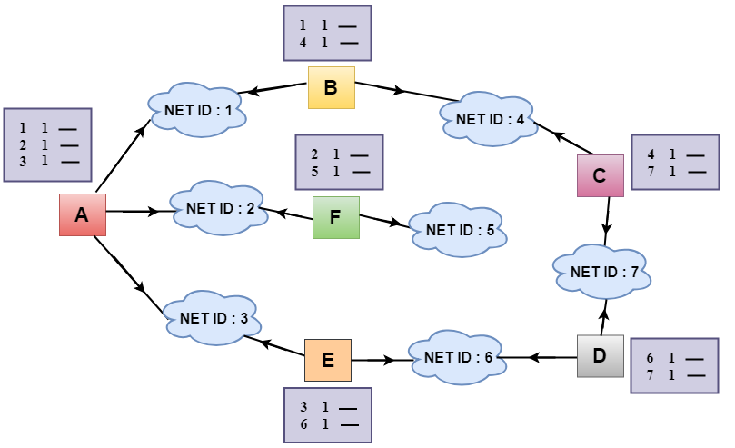
In the above figure, the original routing tables are shown of all the routers. In a routing table, the first column represents the network ID, the second column represents the cost of the link, and the third column is empty.
These routing tables are sent to all the neighbors.

Slide 12
For Example:
A sends its routing table to B, F & E.
B sends its routing table to A & C.
C sends its routing table to B & D.
D sends its routing table to E & C.
E sends its routing table to A & D.
F sends its routing table to A.

Slide 13
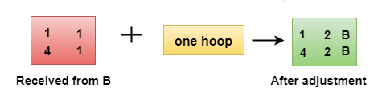
Updating the Table
When A receives a routing table from B, then it uses its information to update the table.
The routing table of B shows how the packets can move to the networks 1 and 4.
The B is a neighbor to the A router, the packets from A to B can reach in one hop. So, 1 is added to all the costs given in the B's table and the sum will be the cost to reach a particular network.

Slide 14
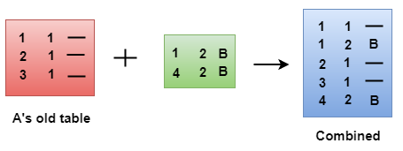
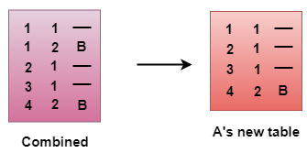
After adjustment, A then combines this table with its own table to create a combined table.
The combined table may contain some duplicate data. In the above figure, the combined table of router A contains the duplicate data, so it keeps only those data which has the lowest cost. For example, A can send the data to network 1 in two ways. The first, which uses no next router, so it costs one hop. The second requires two hops (A to B, then B to Network 1). The first option has the lowest cost, therefore it is kept and the second one is dropped.
The process of creating the routing table continues for all routers. Every router receives the information from the neighbors, and update the routing table.

Slide 15
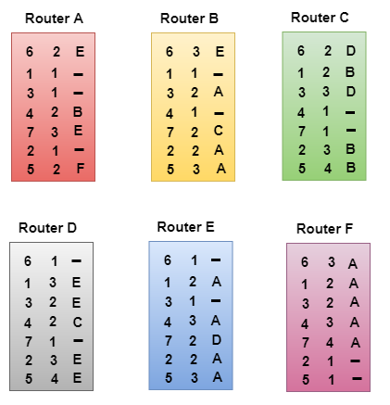
Final routing tables of all the routers are given below

Slide 16
Link State Routing
Link state routing is a technique in which each router shares the knowledge of its neighborhood with every other router in the internetwork.
The three keys to understand the Link State Routing algorithm:
Knowledge about the neighborhood: Instead of sending its routing table, a router sends the information about its neighborhood only. A router broadcast its identities and cost of the directly attached links to other routers.
Flooding: Each router sends the information to every other router on the internetwork except its neighbors. This process is known as Flooding. Every router that receives the packet sends the copies to all its neighbors. Finally, each and every router receives a copy of the same information.
Information sharing: A router sends the information to every other router only when the change occurs in the information.

Slide 17
Link State Routing has two phases
Reliable Flooding
Initial state: Each node knows the cost of its neighbors.
Final state: Each node knows the entire graph.
Route Calculation
Each node uses Dijkstra's algorithm on the graph to calculate the optimal routes to all nodes.
The Link state routing algorithm is also known as Dijkstra's algorithm which is used to find the shortest path from one node to every other node in the network.
The Dijkstra's algorithm is an iterative, and it has the property that after k^{th} iteration of the algorithm, the least cost paths are well known for k destination nodes.

Slide 18
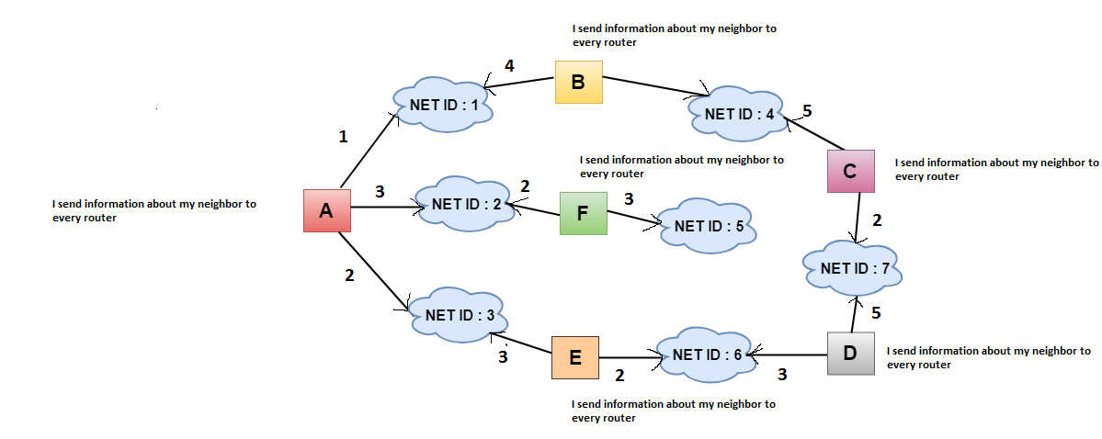
INFORMATION SHARING

Slide 19
In link state cost is a weighted value based on factors such as security levels, traffic or state of the link.
The cost from router A to network ID 1 is different from router A to network ID 2 .
Two factors how cost is applied
1.Cost is applied only by routers not by any other stations on a network.
2. Cost is applied as a packet

Slide 20
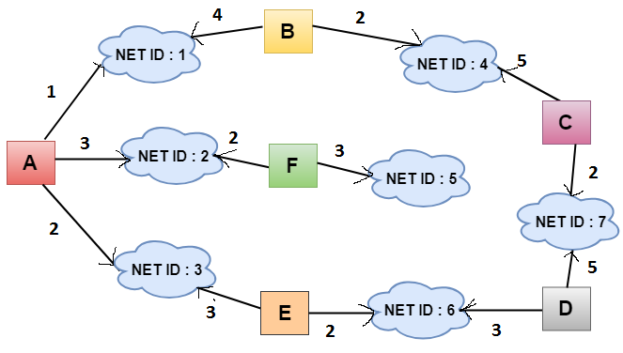
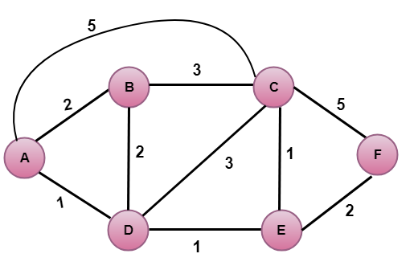
Cost

Slide 21
When a router floods the network with information about its neighbored it is said to be advertising.
The basis of this advertising is a short packet called link state packet (LSP).
It contains 4 fields
1.ID of advertiser
2. ID of destination network
3. cost
4. ID of neighboring router

Slide 22
Advertiser | Network ID | Cost | Neighbor
A | 1 | 1 | B
 | 2 | 3 | F
 | 3 | 2 | E
B | 1 | 4 | A
 | 4 | 2 | C
C | 4 | 5 | B
 | 7 | 2 | D
D | 7 | 5 | C
 | 6 | 3 | E
E | 6 | 2 | D
 | 3 | 3 | A
F | 5 | 3 | --
 | 2 | 2 | A

Slide 23
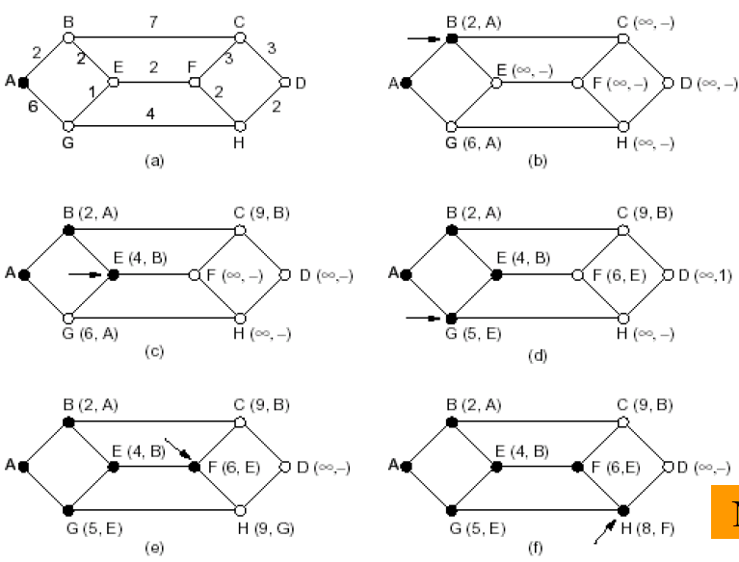
Shortest Path Routing
The shortest path from A to D
is:
ABEFHD

Slide 24
Internet Protocol Version 4 (IPv4)
Internet Protocol is one of the major protocols in the TCP/IP protocols suite.
This protocol works at the network layer of the OSI model and at the Internet layer of the TCP/IP model.
Thus this protocol has the responsibility of identifying hosts based upon their logical addresses and to route data among them over the underlying network.
IP provides a mechanism to uniquely identify hosts by an IP addressing scheme. IP uses best effort delivery, i.e. it does not guarantee that packets would be delivered to the destined host, but it will do its best to reach the destination.
Internet Protocol version 4 uses 32-bit logical address.

Slide 25
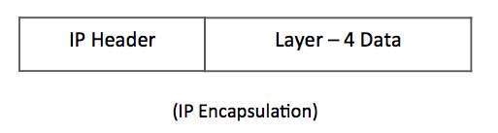
IPv4 - Packet Structure
Internet Protocol being a layer-3 protocol (OSI) takes data Segments from layer-4 (Transport) and divides it into packets.
IP packet encapsulates data unit received from above layer and add to its own header information.
The encapsulated data is referred to as IP Payload. IP header contains all the necessary information to deliver the packet at the other end.

Slide 26
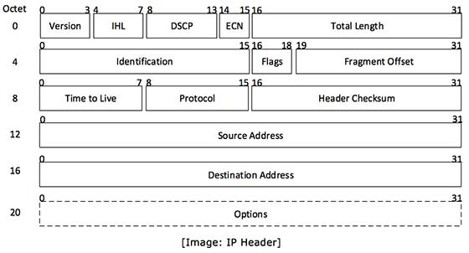
IP header
IP header includes many relevant information including Version Number, which, in this context, is 4.

Slide 27
Version − Version no. of Internet Protocol used (e.g. IPv4).
IHL − Internet Header Length; Length of entire IP header.
DSCP − Differentiated Services Code Point; this is Type of Service.
ECN − Explicit Congestion Notification; It carries information about the congestion seen in the route.
Total Length − Length of entire IP Packet (including IP header and IP Payload).
Identification − If IP packet is fragmented during the transmission, all the fragments contain same identification number. to identify original IP packet they belong to.
Flags − As required by the network resources, if IP Packet is too large to handle, these ‘flags’ tells if they can be fragmented or not. In this 3-bit flag, the MSB is always set to ‘0’.
Fragment Offset − This offset tells the exact position of the fragment in the original IP Packet.

Slide 28
Time to Live − To avoid looping in the network, every packet is sent with some TTL value set, which tells the network how many routers (hops) this packet can cross. At each hop, its value is decremented by one and when the value reaches zero, the packet is discarded.
Protocol − Tells the Network layer at the destination host, to which Protocol this packet belongs to, i.e. the next level Protocol. For example protocol number of ICMP is 1, TCP is 6 and UDP is 17.
Header Checksum − This field is used to keep checksum value of entire header which is then used to check if the packet is received error-free.
Source Address − 32-bit address of the Sender (or source) of the packet.
Destination Address − 32-bit address of the Receiver (or destination) of the packet.
Options − This is optional field, which is used if the value of IHL is greater than 5. These options may contain values for options such as Security, Record Route, Time Stamp, etc.

Slide 29
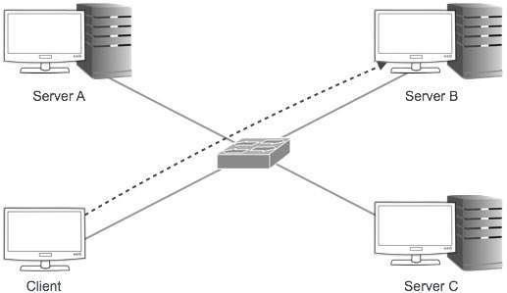
IPv4 - Addressing
IPv4 supports three different types of addressing modes
Unicast Addressing Mode:
In this mode, data is sent only to one destined host. The Destination Address field contains 32- bit IP address of the destination host. Here the client sends data to the targeted server

Slide 30
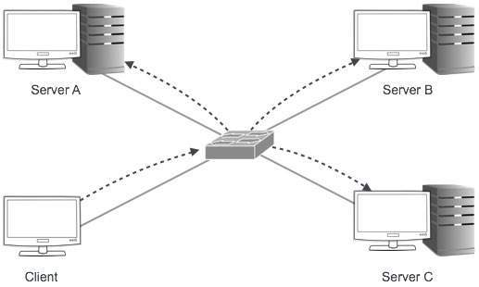
Broadcast Addressing Mode:
In this mode, the packet is addressed to all the hosts in a network segment. The Destination Address field contains a special broadcast address, i.e. 255.255.255.255. When a host sees this packet on the network, it is bound to process it. Here the client sends a packet, which is entertained by all the Servers

Slide 31
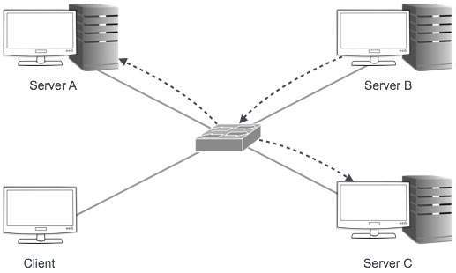
Multicast Addressing Mode :
This mode is a mix of the previous two modes, i.e. the packet sent is neither destined to a single host nor all the hosts on the segment. In this packet, the Destination Address contains a special address which starts with 224.x.x.x and can be entertained by more than one host.

Slide 32

Hierarchical Addressing Scheme:
IPv4 uses hierarchical addressing scheme. An IP address, which is 32-bits in length, is divided into two or three parts as depicted
A single IP address can contain information about the network and its sub-network and ultimately the host. This scheme enables the IP Address to be hierarchical where a network can have many sub-networks which in turn can have many hosts.

Slide 33
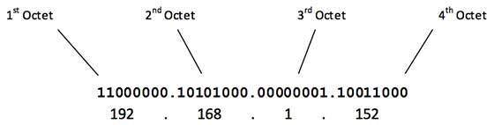
IPv4 - Address Classes
Internet Protocol hierarchy contains several classes of IP Addresses to be used efficiently in various situations as per the requirement of hosts per network.
Broadly, the IPv4 Addressing system is divided into five classes of IP Addresses. All the five classes are identified by the first octet of IP Address.
The first octet referred here is the left most of all. The octets numbered as follows depicting dotted decimal notation of IP Address −
The number of networks and the number of hosts per class can be derived by this formula −
When calculating hosts' IP addresses, 2 IP addresses are decreased because they cannot be assigned to hosts, i.e. the first IP of a network is network number and the last IP is reserved for Broadcast IP.

Slide 34

Class A Address
The first bit of the first octet is always set to 0 (zero). Thus the first octet ranges from 1 – 127, i.e.
Class A addresses only include IP starting from 1.x.x.x to 126.x.x.x only. The IP range 127.x.x.x is reserved for loopback IP addresses.
The default subnet mask for Class A IP address is 255.0.0.0 which implies that Class A addressing can have 126 networks (2⁷-2) and 16777214 hosts (2²⁴-2).
Class A IP address format is thus: 0NNNNNNN.HHHHHHHH.HHHHHHHH.HHHHHHHH

Slide 35

Class B Address
An IP address which belongs to class B has the first two bits in the first octet set to 10, i.e.
Class B IP Addresses range from 128.0.x.x to 191.255.x.x. The default subnet mask for Class B is 255.255.x.x.
Class B has 16384 (2¹⁴) Network addresses and 65534 (2¹⁶-2) Host addresses.
Class B IP address format is: 10NNNNNN.NNNNNNNN.HHHHHHHH.HHHHHHHH

Slide 36

Class C Address
The first octet of Class C IP address has its first 3 bits set to 110, that is −
Class C IP addresses range from 192.0.0.x to 223.255.255.x. The default subnet mask for Class C is 255.255.255.x.
Class C gives 2097152 (2²¹) Network addresses and 254 (2⁸-2) Host addresses.
Class C IP address format is: 110NNNNN.NNNNNNNN.NNNNNNNN.HHHHHHHH

Slide 37

Class D Address
Very first four bits of the first octet in Class D IP addresses are set to 1110, giving a range of −
Class D has IP address range from 224.0.0.0 to 239.255.255.255. Class D is reserved for Multicasting. In multicasting data is not destined for a particular host, that is why there is no need to extract host address from the IP address, and Class D does not have any subnet mask.
Class E Address
This IP Class is reserved for experimental purposes only for R&D or Study. IP addresses in this class ranges from 240.0.0.0 to 255.255.255.254. Like Class D, this class too is not equipped with any subnet mask.

Slide 38
Internet Protocol v6 (IPv6)
IETF (Internet Engineering Task Force) has redesigned IP addresses to mitigate the drawbacks of IPv4.
The new IP address is version 6 which is 128-bit address, by which every single inch of the earth can be given millions of IP addresses.
Today majority of devices running on Internet are using IPv4 and it is not possible to shift them to IPv6 in the coming days.
There are mechanisms provided by IPv6, by which IPv4 and IPv6 can co-exist unless the Internet entirely shifts to IPv6 −
Dual IP Stack
Tunneling (6to4 and 4to6)
NAT Protocol Translation

Slide 39
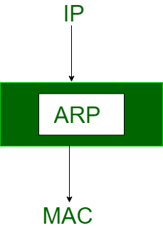
Address Resolution Protocol (ARP)
Most of the computer programs/applications use logical address (IP address) to send/receive messages, however the actual communication happens over the physical address (MAC address) i.e from layer 2 of OSI model.
So our mission is to get the destination MAC address which helps in communicating with other devices.
This is where ARP comes into the picture, its functionality is to translate IP address to physical address.

Slide 40
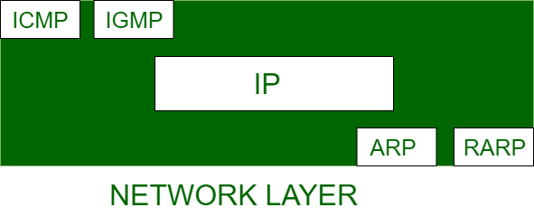
The acronym ARP stands for Address Resolution Protocol which is one of the most important protocols of the Network layer in the OSI model.
Note: ARP finds the hardware address, also known as Media Access Control (MAC) address, of a host from its known IP address.

Slide 41
Address Resolution Protocol is a communication protocol used for discovering physical address associated with given network address.
Typically, ARP is a network layer to data link layer mapping process, which is used to discover MAC address for given Internet Protocol Address.
In order to send the data to destination, having IP address is necessary but not sufficient;
we also need the physical address of the destination machine. ARP is used to get the physical address (MAC address) of destination machine.

Slide 42
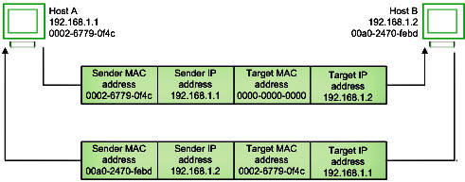

Slide 43
Let’s look at how ARP works.
Imagine a device wants to communicate with the other over the internet. What ARP does?
It broadcast a packet to all the devices of the source network.
The devices of the network peel the header of the data link layer from the protocol data unit (PDU) called frame and transfers the packet to the network layer (layer 3 of OSI) where the network ID of the packet is validated with the destination IP’s network ID of the packet and if it’s equal then it responds to the source with the MAC address of the destination, else the packet reaches the gateway of the network and broadcasts packet to the devices it is connected with and validates their network ID
The above process continues till the second last network device in the path to reach the destination where it gets validated and ARP, in turn, responds with the destination MAC address.

Slide 44
Before sending the IP packet, the MAC address of destination must be known.
If not so, then sender broadcasts the ARP-discovery packet requesting the MAC address of intended destination.
Since ARP-discovery is broadcast, every host inside that network will get this message but the packet will be discarded by everyone except that intended receiver host whose IP is associated.
Now, this receiver will send a unicast packet with its MAC address (ARP-reply) to the sender of ARP-discovery packet. After the original sender receives the ARP-reply, it updates ARP-cache and start sending unicast message to the destination.

Slide 45
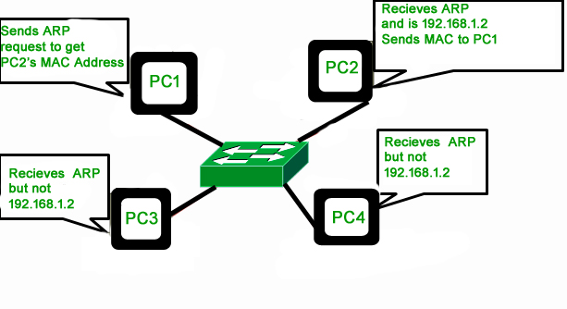

Slide 46
The important terms associated with ARP are
ARP Cache: After resolving MAC address, the ARP sends it to the source where it stores in a table for future reference. The subsequent communications can use the MAC address from the table
ARP Cache Timeout: It indicates the time for which the MAC address in the ARP cache can reside
ARP request: This is nothing but broadcasting a packet over the network to validate whether we came across destination MAC address or not.
  The physical address of the sender.
  The IP address of the sender.
  The physical address of the receiver
  The IP address of the receiver
ARP response/reply: It is the MAC address response that the source receives from the destination which aids in further communication of the data.

Slide 47
CASE-1: The sender is a host and wants to send a packet to another host on the same network.
  Use ARP to find another host’s physical address
CASE-2: The sender is a host and wants to send a packet to another host on another network.
  Sender looks at its routing table.
  Find the IP address of the next hop (router) for this destination.
  Use ARP to find the router’s physical address

Slide 48
CASE-3: the sender is a router and received a datagram destined for a host on another network.
  Router check its routing table.
  Find the IP address of the next router.
  Use ARP to find the next router’s physical address.
CASE-4: The sender is a router that has received a datagram destined for a host in the same network.
  Use ARP to find this host’s physical address.
NOTE: An ARP request is a broadcast, and an ARP response is a Unicast.

Slide 49
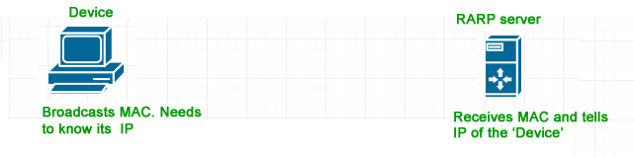
Reverse Address Resolution Protocol (RARP)
Reverse ARP is a networking protocol used by a client machine in a local area network to request its Internet Protocol address (IPv4) from the gateway-router’s ARP table.
The network administrator creates a table in gateway-router, which is used to map the MAC address to corresponding IP address.
When a new machine is setup or any machine which don’t have memory to store IP address, needs an IP address for its own use. So the machine sends a RARP broadcast packet which contains its own MAC address in both sender and receiver hardware address field.

Slide 50
A special host configured inside the local area network, called as RARP-server is responsible to reply for these kind of broadcast packets. Now the RARP server attempt to find out the entry in IP to MAC address mapping table. If any entry matches in table, RARP server send the response packet to the requesting device along with IP address.
LAN technologies like Ethernet, Ethernet II, Token Ring and Fiber Distributed Data Interface (FDDI) support the Address Resolution Protocol.
RARP is not being used in today’s networks. Because we have much great featured protocols like BOOTP (Bootstrap Protocol) and DHCP( Dynamic Host Configuration Protocol).

